Slide 1
Machine Learning

Slide 2
How Do You Decide Which Algorithm to Use?
Choosing the right algorithm can seem overwhelming—there are dozens of supervised and unsupervised machine learning algorithms, and each takes a different approach to learning.
There is no best method or one size fits all.
Finding the right algorithm is partly just trial and error—even highly experienced data scientists can’t tell whether an algorithm will work without trying it out.
But algorithm selection also depends on the size and type of data you’re working with, the insights you want to get from the data, and how those insights will be used.

Slide 3
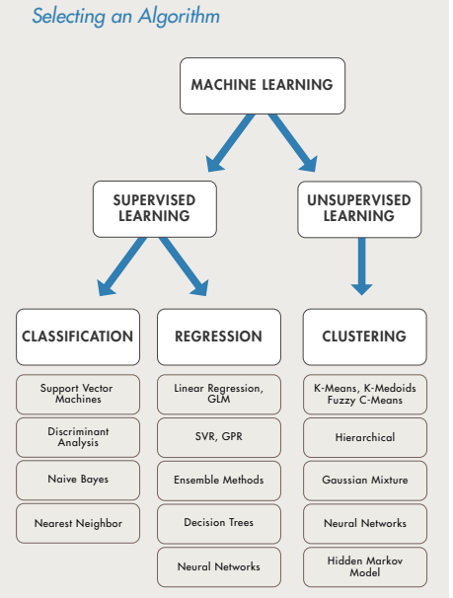

Slide 4
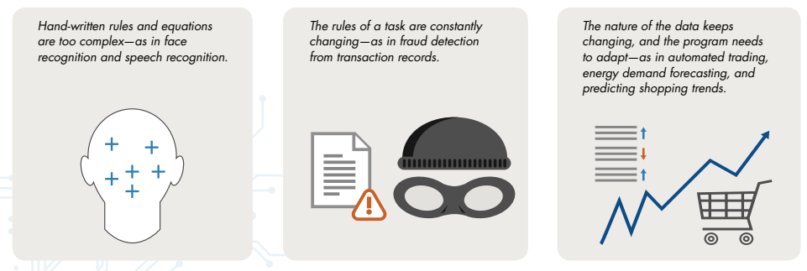
When Should You Use Machine Learning?
Consider using machine learning when you have a complex task or problem involving a large amount of data and lots of variables, but no existing formula or equation. For example, machine learning is a good option if you need to handle situations like these:

Slide 5
Real-World Examples
Detecting Low-Speed Car Crashes
With more than 8 million members, the RAC is one of the UK’s largest motoring organizations, providing roadside assistance, insurance, and other services to private and business motorists. To enable rapid response to roadside incidents, reduce crashes, and mitigate insurance costs, the RAC developed an onboard crash sensing system that uses advanced machine learning algorithms to detect lowspeed collisions and distinguish these events from more common driving events, such as driving over speed bumps or potholes. Independent tests showed the RAC system to be 92% accurate in detecting test crashes

Slide 6
Thank You

